Slide 1

Deep Learning Course Project
Ezra Lee

Slide 2
Introduction
Goal: To perform analysis on pictures of birds and successfully return the classification of those birds, with a model accuracy of greater than or equal to 80%.
In the past, convolutional neural networks have been the most frequent and standard model used for image recognition and object detection, and with rapid improvement and research the quality and effectiveness of these models have progressed tremendously.

Slide 3
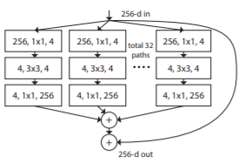
Introduction
With an increasing number of hyper-parameters that a model needs to process, architectures for deep networks to effectively learn these parameters have diversified and contain a vast variety of different approaches.
The ResNeXt [1] architecture consists of repeating layers of hyper-parameters while splitting the input into fewer lower-dimensional embeddings then transforming it by a set of specialized filters and then merged by concatenation.

Slide 4
Introduction
In visual object recognition, category-level classification is mostly used, but it is only effective in rough distinctions between object classes and fails to make distinctions with smaller interclass differences and finer details.
In this project, a training scheme for large scale fine-grained categorization with high performance on ImageNet will be applied to a small-scale fine-grained dataset such as the CUB_200_2011 birds dataset through transfer learning.

Slide 5
Previous Work
Convolutional Neural Networks
Convolutional neural networks (CNN) typically have a standard structure with stacked convolutional layers followed by one or more fully-connected layers.
One of the most successful previous methods of object detection have been Regions with Convolutional Neural Networks (R-CNN).

Slide 6
Previous Work
Fine-grained Image Recognition
A way in handling fine-grained recognition problems is to apply visual bag-of-words approaches commonly used for standard object categorization.
One method in handling fine-grained recognition is to reduce background clutter which could interfere in classification using segmentation techniques [8].

Slide 7
Previous Work
Transfer Learning
CNNs trained on the ImageNet [5] database have been popularly used for transfer learning, through the use of pre-trained networks for fine-tuning or as a feature extractor [9].
Cui et al. [4] demonstrates the use of modern neural network architectures to obtain significantly higher accuracy predictions, through quantifying the similarity between the source and target domain and then choosing a more similar subset from the source domain for better transfer learning.

Slide 8
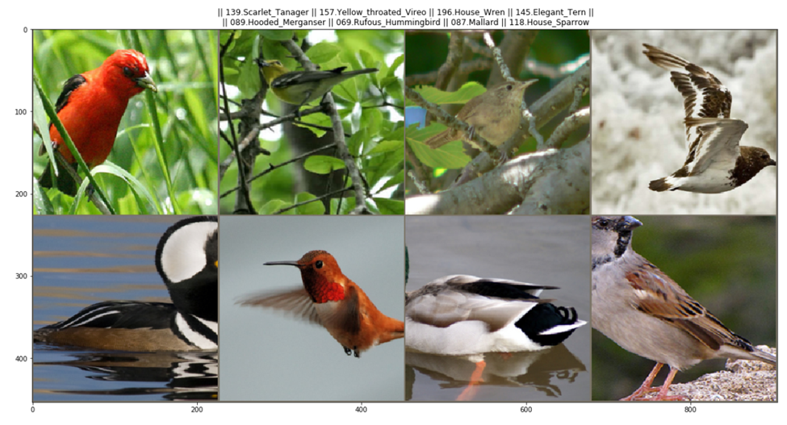
Methodology
Implementation
The Caltech-UCSD Birds-200-2011 (CUB-200-2011) dataset contains 200 different classes with 11,788 images in total, with 15 part locations, 312 binary attributes, and 1 bounding box as annotations per image.
Images are then split between training and testing sets using the supplied train_test_split.txt file included in the dataset file, which results in 5994 images in the training set and 5794 images in the testing set, each within their own files.

Slide 9
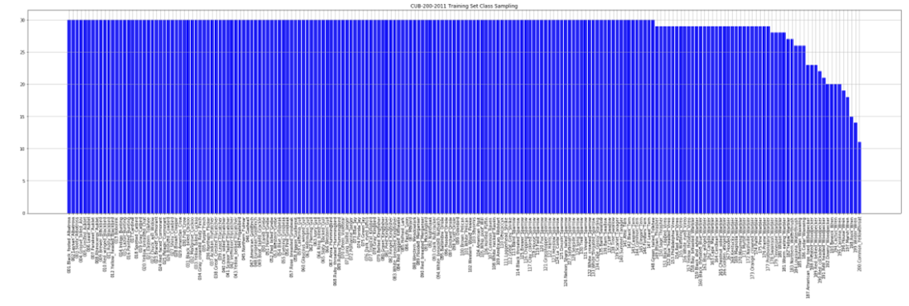
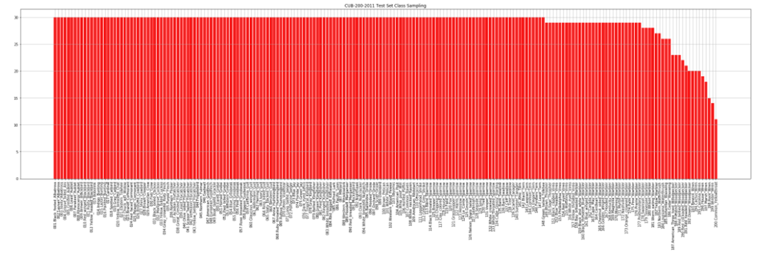
Methodology
Figure. Top: Class sampling of training set. Bottom: Class sampling of testing set
The sampling distribution of classes between both sets is almost equal. The distribution between all the classes is almost all the same with 30 images, with the exception of a few.

Slide 10
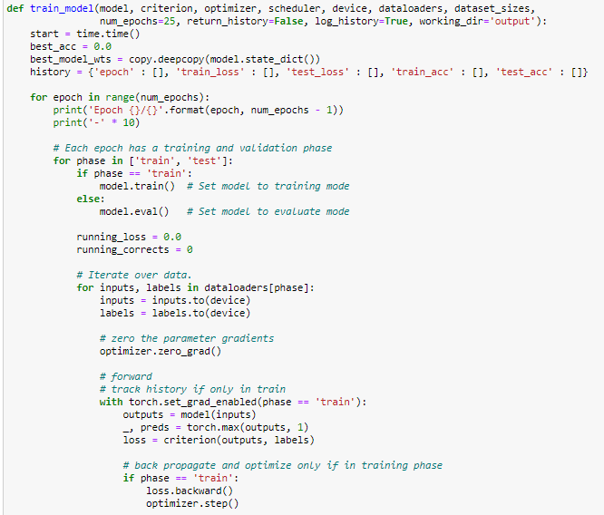
Methodology
Functions
There were many functions created to encapsulate specific portions of the code for ease in implementation.
def train_model(model, criterion, optimizer, scheduler, device, dataloaders, dataset_sizes, num_epochs=25, return_history=False, log_history=True, working_dir='output’)
Builds and trains a CNN model given a pretrained model, loss function, optimizer, scheduler, and number of epochs.

Slide 11
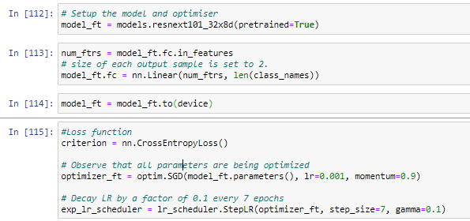
Methodology
After the preprocessing has been completed, the device to run the training is set to the GPU, and the ResNeXt 101 32x8d[7] model with pretrained weights is loaded in.
The loss function chosen for training is cross-entropy (−(ylog(p)+(1−y)log(1−p))), the optimizer chosen to update parameters is Stochastic Gradient Descent with a learning rate of 0.01 and momentum of 0.09, and the scheduler for the optimizer is set with a step size of 7 and a gamma (learning rate decay) of 0.1.

Slide 12
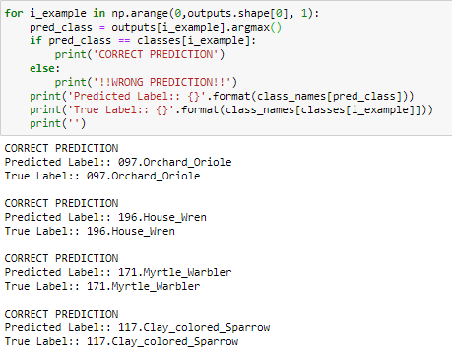
Methodology
Once the model is finished training, the best validation accuracy is returned with the best model saved in a pkl file. With the fully trained model, analysis and results can be computed through various tables and graphs.
To use the model to classify images not contained within the dataset, the model is set to evaluation mode and the new images are loaded into the model with the classification returned.

Slide 13
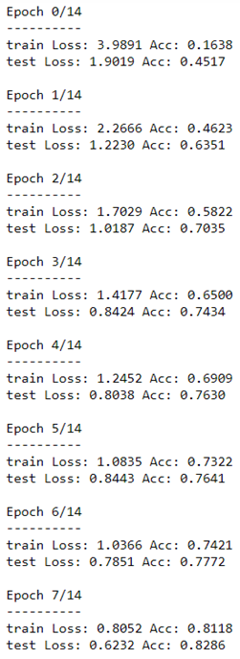
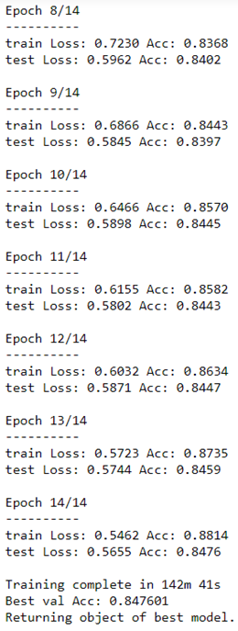
Results & Analysis
Figure: The results of model training at each epoch.
The best validation accuracy result was 0.848, which meets the standard of above 80% accuracy expected for the classification model.

Slide 14
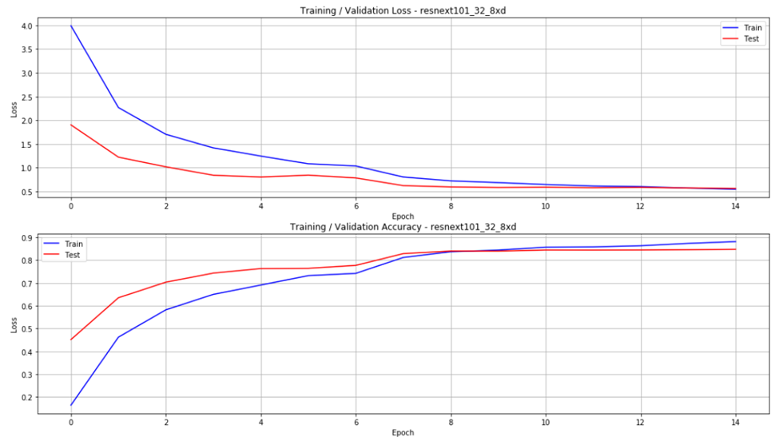
Results & Analysis
Figure: Graph of Loss and Accuracy for Training and Validation
The initial loss for both training and validation was high, with the training loss roughly double that of the validation loss. The same pattern goes for the accuracy, where the validation accuracy roughly doubles that of the training accuracy.
Both graphs show the loss and accuracy converging and maintaining roughly the same value over time, which shows no signs of overfitting or underfitting, making this a strong model.

Slide 15
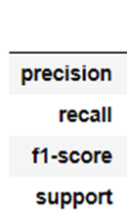
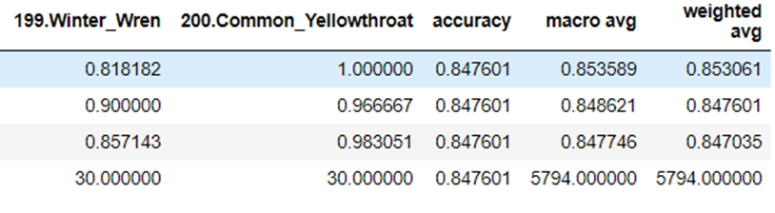
Results & Analysis
To evaluate the performance of the model, a variety of metrics are calculated.
From the table, the average values for all 4 metrics are almost equal, indicating that the model is balanced and performing consistently across all the data.
Table: Subset of the classification report. Contains precision, recall, f1-score, and class length, along with the averages.

Slide 16
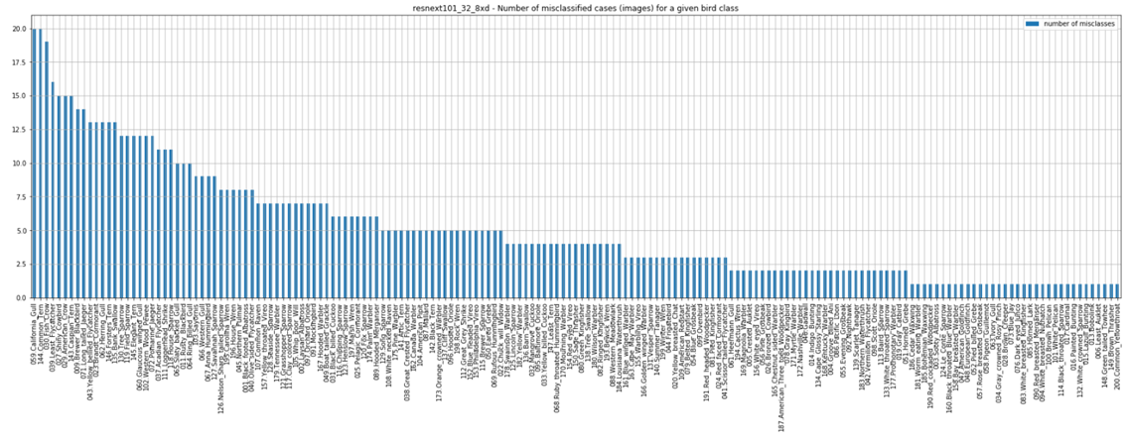
Results & Analysis
Figure: Graph of missclassified images for each class

Slide 17
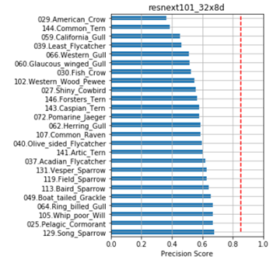
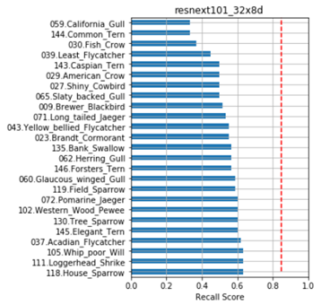
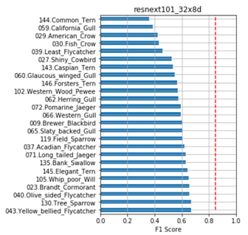
Results & Analysis
The 25 classes with the worst scores are displayed. It can be seen that Gulls, Crows, Terns, and Ravens are the collective classes that perform the worst in this model.
This leads to a higher frequency of misclassified images resulting in these poor scores, shown with the California Gull, Common Tern, and Fish Crow as the three most missclassified, with 20, 20, and 19 out of 30 respectively.
Figure: Chart of Precision, Recall, and F1 score of the 25 worst class performers

Slide 18
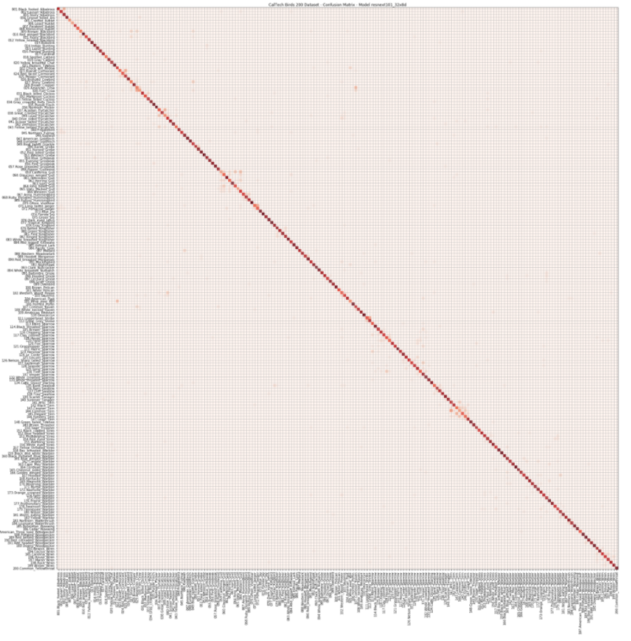
Results & Analysis
Figure: Confusion matrix of all bird classes
The confusion matrix shows how all the classes performed relative to each other.
The Gulls bird class was the worst performer out of all the classes and is represented in the confusion matrix as the cluster of scattered weak heat squares around the diagonal.

Slide 19
Conclusion
Goal: To perform analysis on pictures of birds and successfully return the classification of those birds, with a model accuracy of greater than or equal to 80%.
The training set contained 5994 images and the testing set contained 5794 images and was classified using a combination of various image augmentations, cross-entropy loss as the activation function, mini-batch stochastic gradient descent, and the ResNeXt 101 32x8d convolutional neural networks approach to produce learning models.
Through the supervised learning method, backpropagation was used in training the model.
The best average statistical accuracy was returned at 84%, which is successfully above the 80% benchmark proposed for the project.

Slide 20
References
[1] https://arxiv.org/pdf/1611.05431.pdf
[2] https://arxiv.org/pdf/1409.4842.pdf
[3] https://www.cv-foundation.org/openaccess/content_cvpr_2014/papers/Goring_Nonparametric_Part_Transfer_2014_CVPR_paper.pdf
[4] https://arxiv.org/pdf/1806.06193.pdf
[5] http://www.image-net.org/papers/imagenet_cvpr09.pdf
[6] https://towardsdatascience.com/adventures-in-pytorch-image-classification-with-caltech-birds-200-part-1-the-dataset-6e5433e9897c
[7] https://pytorch.org/hub/facebookresearch_WSL-Images_resnext/
[8] https://www.robots.ox.ac.uk/~vgg/publications/2011/Chai11/chai11.pdf
[9] https://arxiv.org/pdf/1403.6382.pdf
[10] https://arxiv.org/pdf/1406.5774.pdf

